Slide 1
LINK
GROUP
LINK
Automation Engineering (Shanghai) Co.,Ltd.
GROUP
霖和自动化工程(上海)有限公司
Training Record
Pham Tung Lam : PLC Engineer
Module Safety

Slide 2
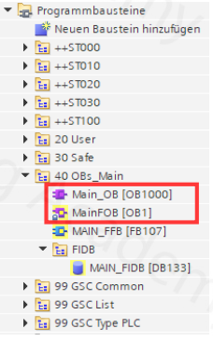
SAFE CONCEPT GSC
The safety program is called up cyclically and is therefore synchronous to the standard program . The F-runtime group is processed before the standard program. → The number of the standard OB is greater than the F-runtime group OB
This increases the protection against manipulation from the standard program

Slide 3
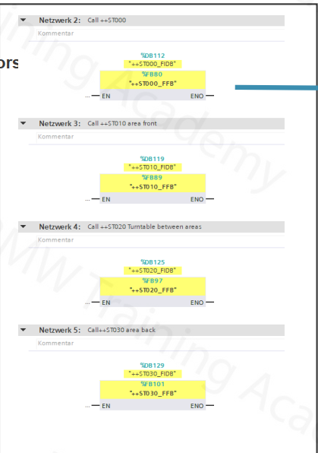
In the GSC zone concept, the safe actuators are switched off regardless of the call structure in the safety program.
In the main FFB all stations called one after the other.

Slide 4
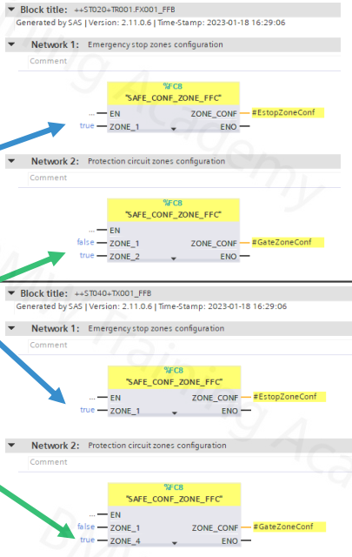
The zone used is configured in each component in the various stations.
ST020 tool and ST040 conveyor technology each use E-STOP circle 1
ST020 tool uses SAFETY GATE circuit 2 ST040 conveyor technology uses SAFETY GATE circuit 4

Slide 5
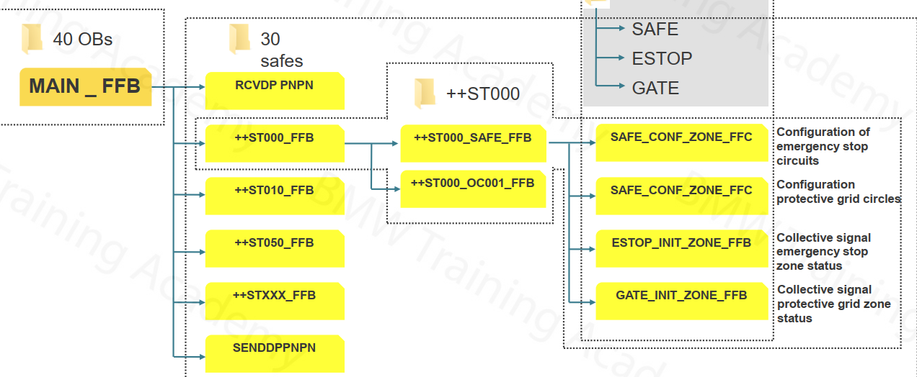
OVERVIEW | SAFE STRUCTURE

Slide 6
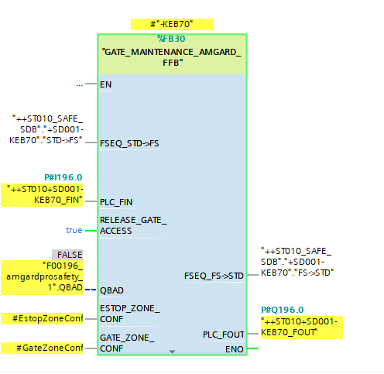
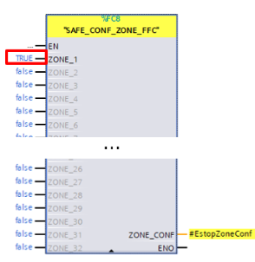
In the F-program, the system programmer has the following options
1-32 emergency stop zones
1-32 gate zones (protective circuit zones)
Each safety device need to be assigned a zone and estop zone number

Slide 7
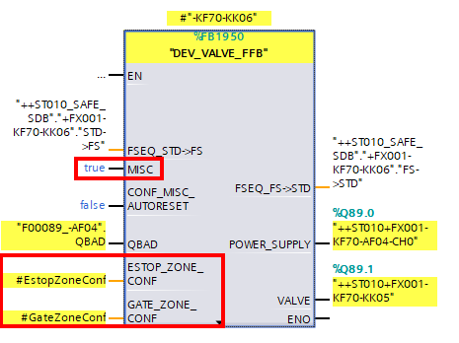
_ All safe actuators contain the following saving releases
_ The emergency stop and protective circuit releases are canceled or acknowledged by the zone configured on the actuator.
_ The MISC release is available at the actuators (as far as provided by the standard) as a discrete input at the failsafe modules of the actuators.
_ The "MISC" input can be used to implement other safe deactivations that cannot be implemented with the zone concept.
_ By default, discrete deactivations of individual or a small number of actuators are implemented in the GSC (operator's loading station).

Slide 9



Contact Us
LINK Group Headquarter
Shanghai, China
LINK Group North China
Shenyang, China
LINK Group Europe (LKGG GmbH)
Bad Reichenhall, Germany
Enquiry
Enquiry
Enquiry
ying.liu@LKautomation.com
kimi.wang@LKautomation.com
jackey.yin@LKautomation.com
+86 021 6918 0161
+86 021 6918 0161
+86 186 2171 9367
Sales
Sales
Sales
gene.zhang@LKautomation.com
gene.zhang@LKautomation.com
andreas.reymendt@LKautomation.com
+86 136 2179 1621
+86 136 2179 1621
Address
BLDG #D,North Jiasong Road No.3570 Jiading District,Shanghai,P.R.China
Address
NO. 14 22nd Floor,NO.168-3 Harbin Road,
Shenhe District,Shenyang,Liaoning
Province,P.R.China
Address
Fischerbraeuwiese 18b,83435 Bad
Reichenhall,Bavaria,Germany

